Slide 1
Primary care in Finland
Trends 2010 – 2012
In Särö 6.9.2012
Arto Virtanen

Slide 2
Topics
Health care reform
Privatisation
Positive trends for general medicine
Salaries

Slide 3
Arto Virtanen
GP in Nurmijärvi County since 1985
Rajamäki Health station in Nurmijärvi:
Nurmijärvi has 41000 inhabitants,
40km north of Helsinki
Rajamäki has 6000 inhabitants, 3 GP:s
Non-specialist
GPF Board since 2002
GPF Chair since 2011

Slide 4
Municipalities responsabilities are changing
Soon?
Municipalities
organize primary and are responsoble for secondary care
Universityhospital districts (5)
Organize tertiary care
Before
Municipalities
Organize Primary Care
Hospital districts
Municipalities as members
Organize secondary care
Organize tertiary care

Slide 5
Reasonings for systemchange
primary and secondary care should work together, in the same organisation
The social sector should be also included in this
Many municipalities are too small to arrange local healthcare by themselves.
In the same time a big political issue
A separate central government plan to reduce the number of municipalities more or less drastically
Now over 300, plan: 50?

Slide 6
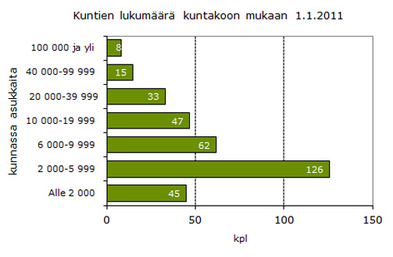
Size and numbers of municipalities 2011

Slide 7
Privatisation
Hole health centers outsourced since 2004
City of Lahti started with its central - region
At peak there were 40 outsourced centers, now 38, soon 40 again (Samaria/Espoo and Hakunila/Vantaa as new ones)
Lack of GP:s
Monetary savings
Organisational changes
Ideological reasons (private = more efficient)
Hired GP:s through companies
Since 2000, first in out of hours work
Now also long lasting contracts

Slide 8
Private Companies (revenue 2011)
Attendo-Medone 250 mill €
Mediverkko 65 mill €
Pihlajalinna 30 mill €
Coronaria 20 mill €
MediRadix 12 mill €
Doctagon 11 mill €
MAST Data 4 mill €
MediVida 2 mill €
Puumedi
Terveydenhuolto.com

Slide 9
How much of the healthproduction-labour is outsourced?
In primary care 7%
In secondary and tetiary care 1,7 %
In both: very wide geographical differences

Slide 10
General medicine is improving its brand
Lack of GP:s is lessening (partly even gone)
General practice as a speciality is gaining popularity
1.1.2012 specialists in different fields:
General medicine: 2882
Internal medicine 1659, psychiatry 1340, General surgery 1266, occupational healthcare 1007

Slide 11
Work-happiness (Lääkärilehti: Harri Haimakainen, Arto Vehviläinen, Esko Kumpusalo Vsk. 66 • Nr: 42 / 2011 • s. 3133 - 3138)
”I would suggest working in a health-center as a career for my children”
2002 39%
2006 52%
2010 60%
”Working in a health-center takes all my powers”
2002 60%
2006 48%
2010 44%
”I will be able to work in a health center up the retirement age”
2002 47%
2006 60%
2010 66%

Slide 12
Working part-time:
1996 5% and 2010 20% of GP:s
Of these: women 2/3 and 1/3 men, the same percentage in all age groups
ICPC vs ICD 10 in Finland:
Physicians use ICD 10 (except a couple of municipalities)
Nurses use ICPC
National data collection of either one

Slide 13
Officially 2 payment systems
Own GP
Responsibility to take care of a named population
Populations usually 1800-2700
Working time not measured
25-40% of payment depending on the workload (fee for service)
Traditional
37 hours/week
10% of payment depends on the workload (fees for service)

Slide 14
Many-many local agreements
Now the majority of GP:s work under different locally agreed work/payment systems
Every health center has different agreements
List models
List of patients (some patients or all patients)
Fee for service: 30-60% of total income
Worries: Motivates to serve shortly many simple patients
Fixed wages
All inclusive
Worries: Motivates to spend time peacefully in the office

Slide 15
Salaries developments
2012-2013 central agreement: 2,4%
2010-2011 development
Normal hours wages +3,6% for physicians
Communal-sector alltogether 2,5%
Total wages the difference 4,3% vs 2,5%
Since 2000 (index 100) wages have risen
Physicians in the communal sector to 160
others in the average to 150

Slide 16
Wages
In Regular hours 2011
6500 € / month GP:s
5800 € / month hospital doctors
GP:s get better payed in start of their career but hospitaldoctors are coming slower to their peak
Wagedevelopment 2009 -2011 among GP:s has been positive
non specialists + 12,8 %
specialists + 6,5%
Difference now about 600€/month

Slide 17
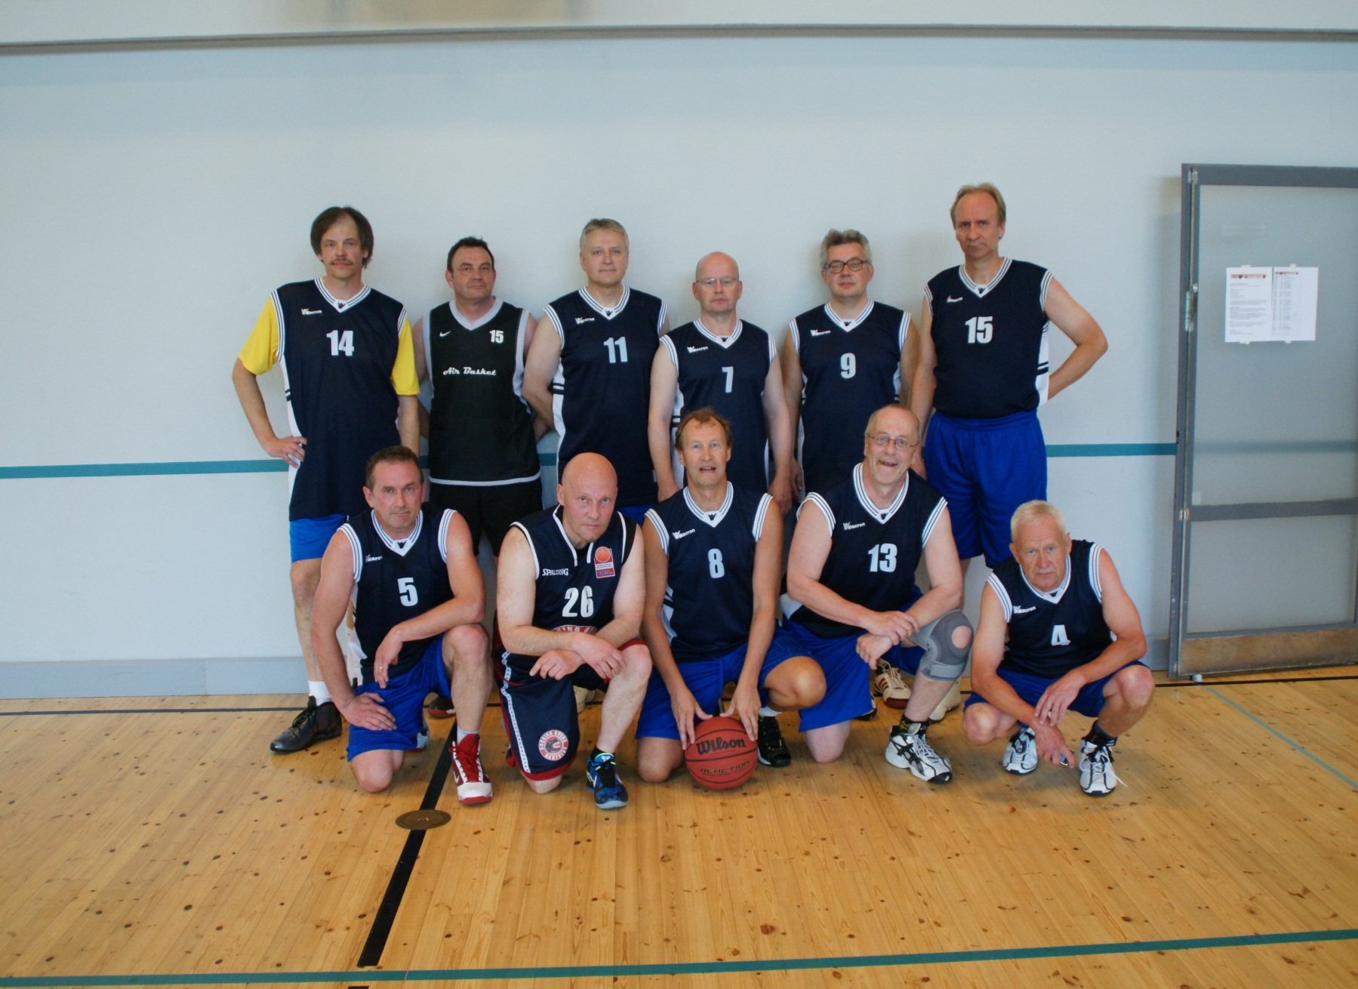
Let´s keep us fit It helps in keeping others fit

